Slide 1
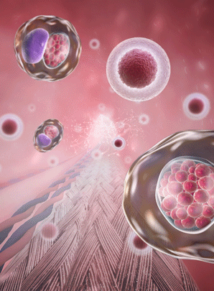
Stem cells and differentiation
AEHBY Human Biology

Slide 2
Review
Describe processes involving DNA in the G1 phase of the cell cycle ( 2 marks)
Use the sliding filament theory to explain why muscles must work in pairs (4 marks)
From the afferent arteriole to the efferent arteriole of the nephron, an increase in blood pressure occurs.
  a) how is this pressure increase achieved
  b) what is the functional purpose of this pressure increase (4 marks)

Slide 3
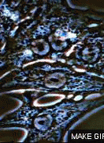
Learning Intentions
Stem cells have the ability to divide by mitosis and differentiate into many different tissues, depending on the level of cell potency.

Slide 4
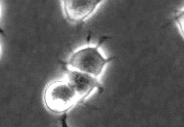
Success criteria
Define stem cell.
Identify three sources of stem cells.
Define proliferation and differentiation.
Classify stem cells as totipotent, pluripotent or multipotent, based on description or source.

Slide 5
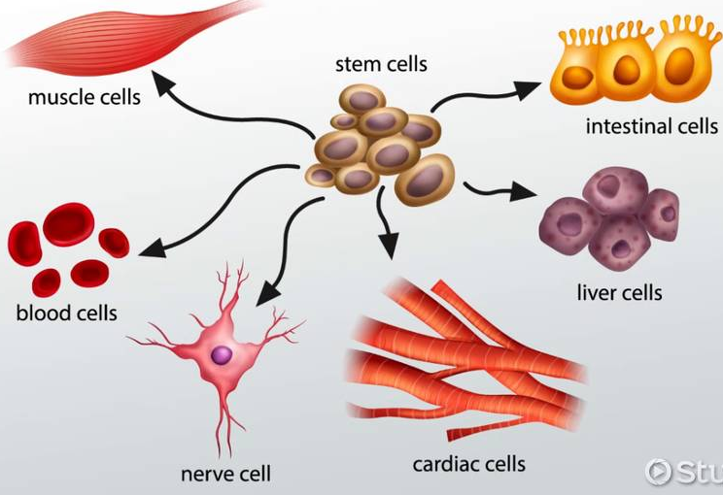
Stem cells and differentiation
Cells can either be stem cells or specialised cells.
Once specialised, cells are unable to undergo division
Which part of the cell cycle are they stuck in?

Slide 6
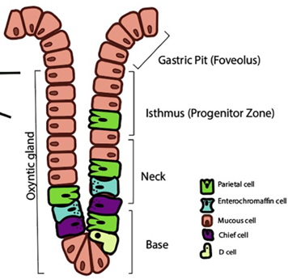
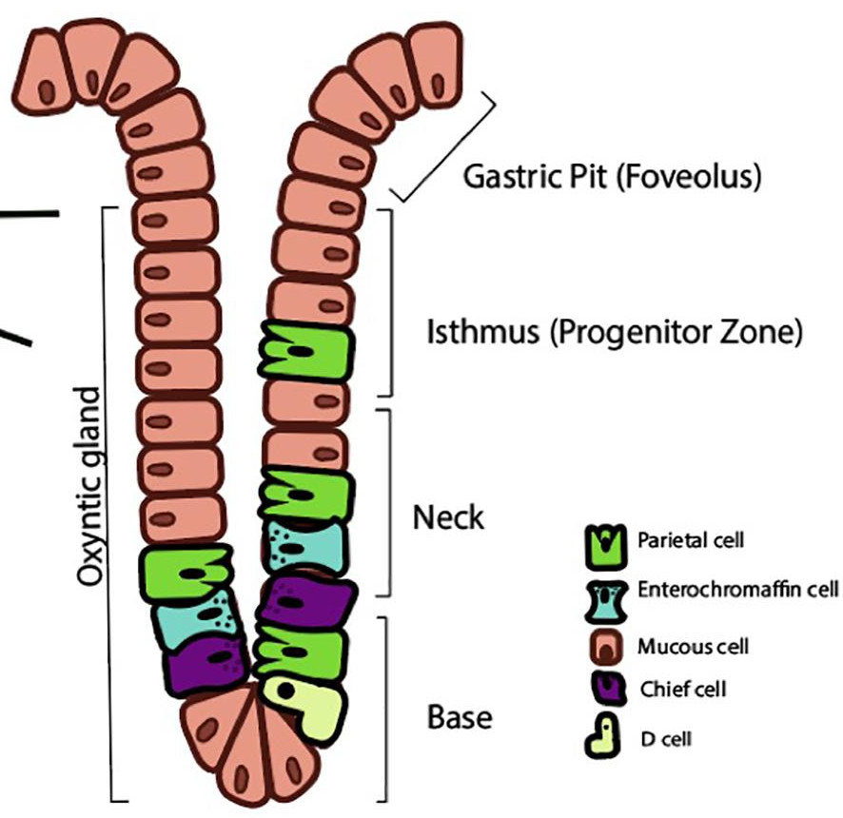
Stem cells and differentiation
Stem cells are able to divide to produce more stem cells (stem cell proliferation) and these can undergo differentiation to become specialised cells. This involves activation of certain genes and inhibition of other genes, a stomach cell ‘unlocks’ the genes for producing enzymes or mucous, a muscle cell ‘unlock’ genes for producing contractile proteins etc.
How are these genes turned on or off?

Slide 7
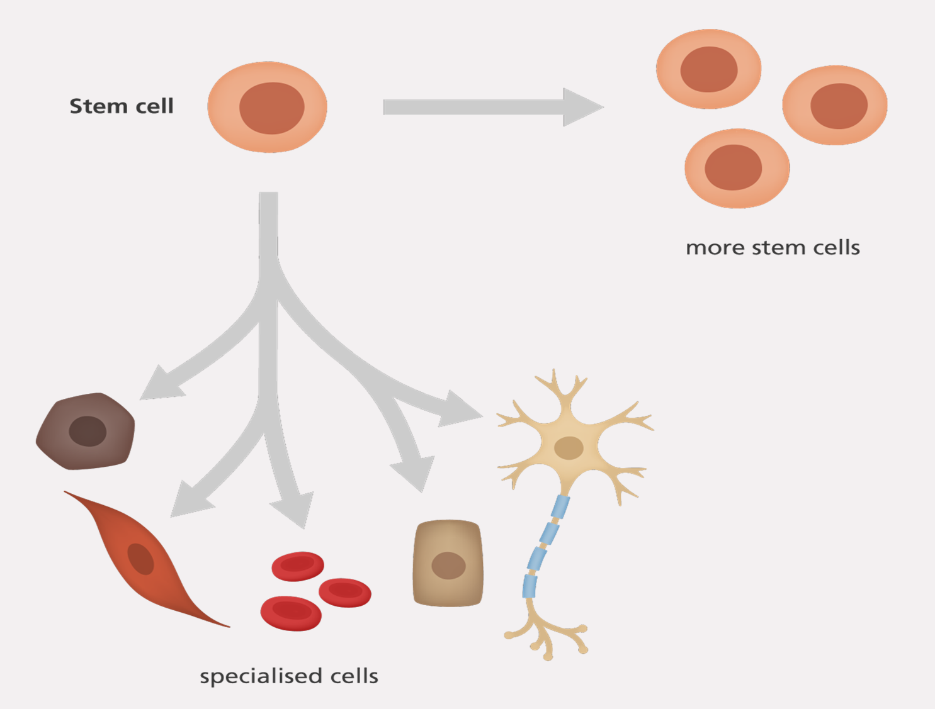

Slide 8
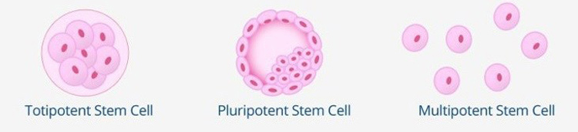
Stem cell classification
Origin – (embryonic, adult, cord blood)
Potency – totipotent, pluripotent, multipotent

Slide 9
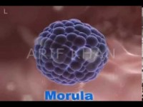

Slide 10
Totipotent
Found only in early embryonic ‘germ stage’, these can become any type of cell in the embryo or membranes that will support or nourish the embryo.

Slide 11
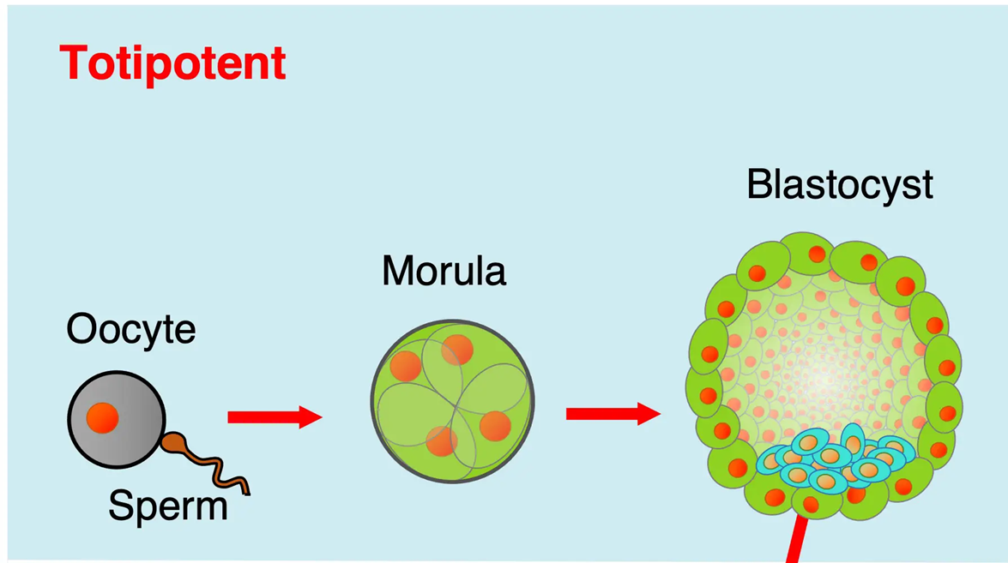

Slide 12


Slide 13
Pluripotent
Found in older embryos, these can differentiate to produce any type of cell in the body.

Slide 15


Slide 16
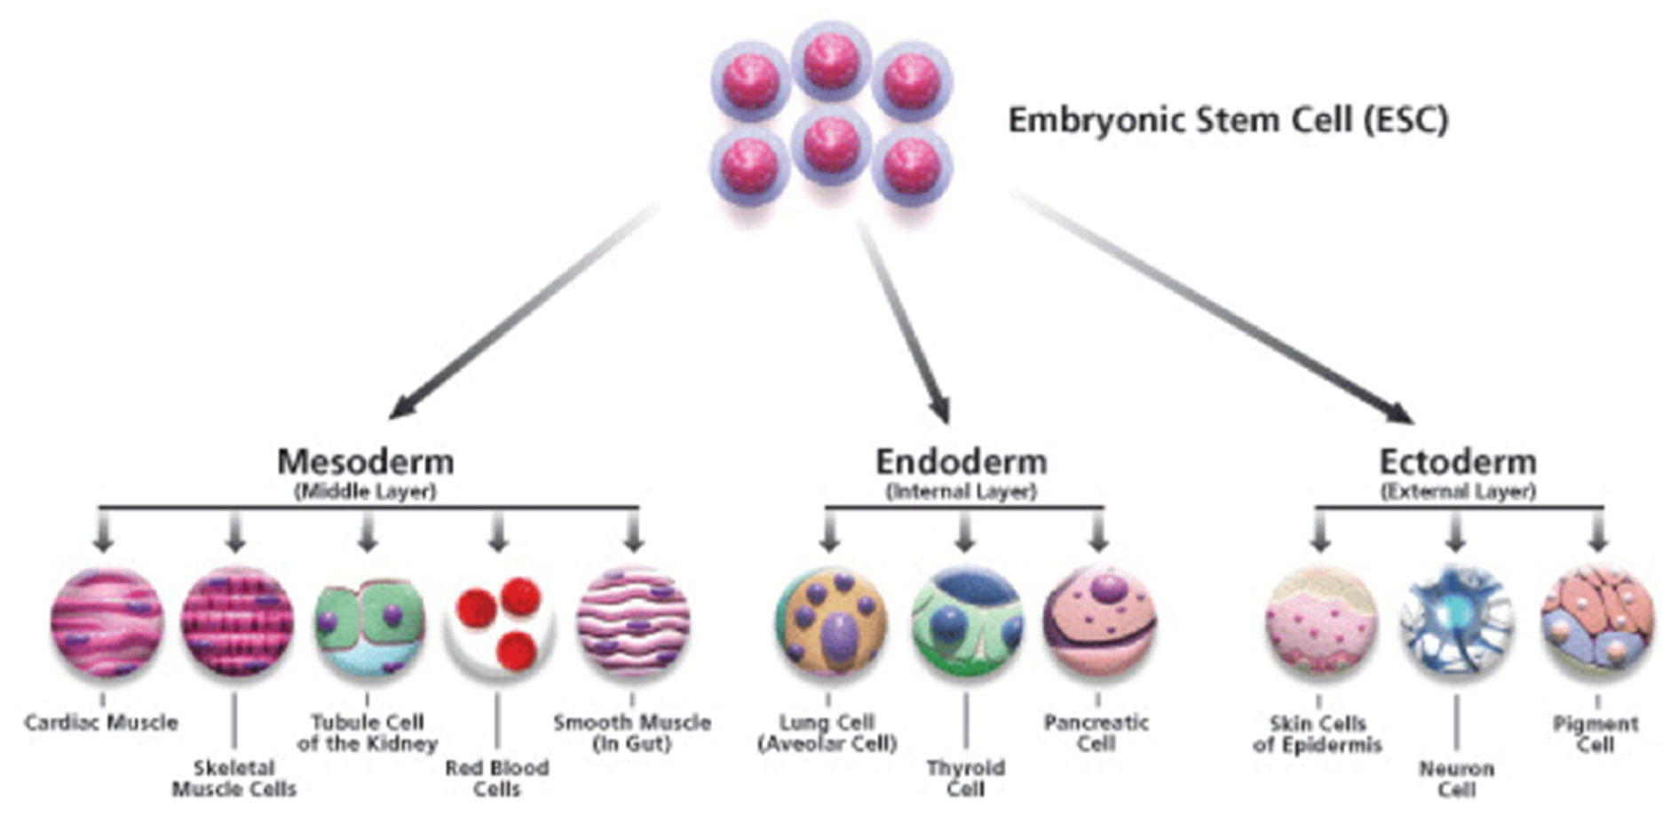

Slide 17
Multipotent
These have the potential to form a number of different types of cells, eg blood stem cells can give rise to red blood cells, white blood cells and platelets; skin stem cells can produce different types of skin cells.
These include adult stem cells, embryonic stem cells and cord blood stem cells.

Slide 18
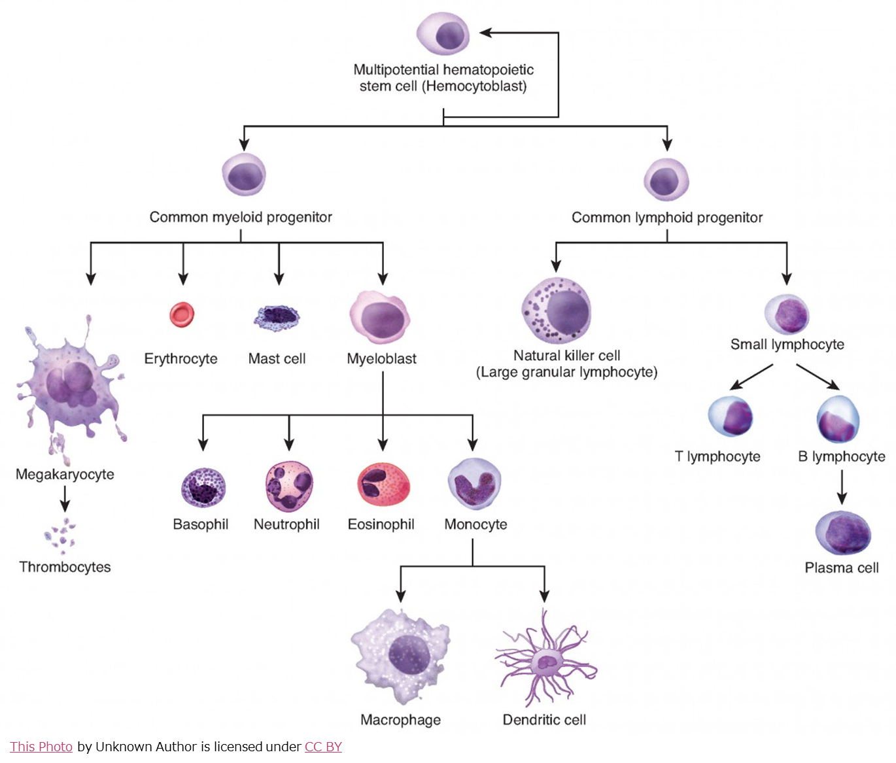

Slide 19
So, can we grow a new clone of you from just a skin cell?
Why/why not?
What mechanism stops a differentiated cell from reverting to a stem cell?

Slide 20
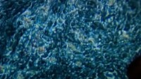

Slide 21
Success criteria
Define stem cell.
Identify three sources of stem cells.
Define proliferation and differentiation.
Classify stem cells as totipotent, pluripotent or multipotent, based on description or source.

